Slide 1
Northeast Tennessee Consortium of School Districts
2024 Regional School Readiness Data
The Niswonger Foundation

Slide 2
School Readiness Definition
Progress toward readiness begins at birth and is influenced by families and friends, early care and education providers, and the community.
A ready child is prepared physically, emotionally, socially, and intellectually. This means that each child enters school ready to participate in and benefit from early learning experiences that best promote the child’s success so that they are eager and excited to learn.
There are five developmental areas for readiness: approaches to learning; physical development; language and literacy; social and personal competency; and cognition/math.

Slide 3
Examples of these areas include but are not limited to:
Approaches to learning: Concepts of print, letter recognition, and number sense, phonological and sound awareness, problem solving and critical thinking
Physical development: Taking care of personal needs (restroom, eating, etc), monitoring personal space and risks, fine motor skills
Language and literacy: Conversation skills and the ability to build relationships, listening, speaking, reading and writing
Social and personal competency: Emotional control, self-awareness, and empathy for others, Endurance, perseverance, and cooperative play
Cognition/math: Sustained attention, information processing, working memory, and pattern recognition

Slide 4
Brigance Early Childhood Screens III
The selected screener is the Brigance Early Childhood Screens III. It is used to
accurately screen skills that are critical predictors of school success, including physical development, language, academic/cognitive, self-help, and social-emotional skills. The assessments are aligned to early learning standards and TN State Standards for children from birth to age 6. Results provide both norm and criterion referenced outcomes. Online data management allows for meeting reporting requirements with normed data and include parent observation forms and involvement resources for early learning.
Screening can serve as the first step in assessing a child’s school readiness, providing a snapshot of a child’s mastery of early developmental and academic skills. Screening also enables educators to readily identify children who may be developmentally delayed and children who may be developmentally advanced and, therefore, can support any intervention that might be needed.

Slide 5
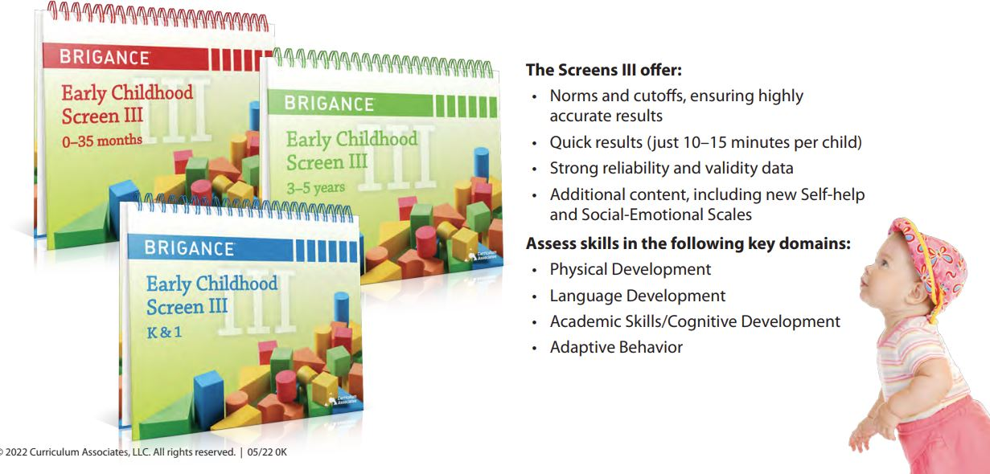
Notes:
Developmental screening is an important part of early childhood education. A developmental screen is a brief assessment that helps to determine a child’s strengths and needs and supports planning appropriate instruction for the child.
The BRIGANCE Early Childhood Screen III, was created based on studies of children across the U.S., including those with disabilities and multiple languages. It takes about 10-15 minutes per child and gives an accurate picture of a child’s development in five areas:
• Academic/Cognitive: early academic skills, such as counting, sorting, and book and letter knowledge
• Language/Communication: basic vocabulary, fluency of speech, and how well speech is understood
• Physical Well-Being: drawing, writing, and using arms and legs to move in different ways
• Self-Help: eating, dressing, and toileting skills
• Social-Emotional: relationships with adults and friends, play skills, self-confidence, and self regulation
Screening also enables educators to readily identify children who may be developmentally delayed and children who may be developmentally advanced and, therefore, can support any intervention that might be needed prior to Kindergarten.

Slide 6
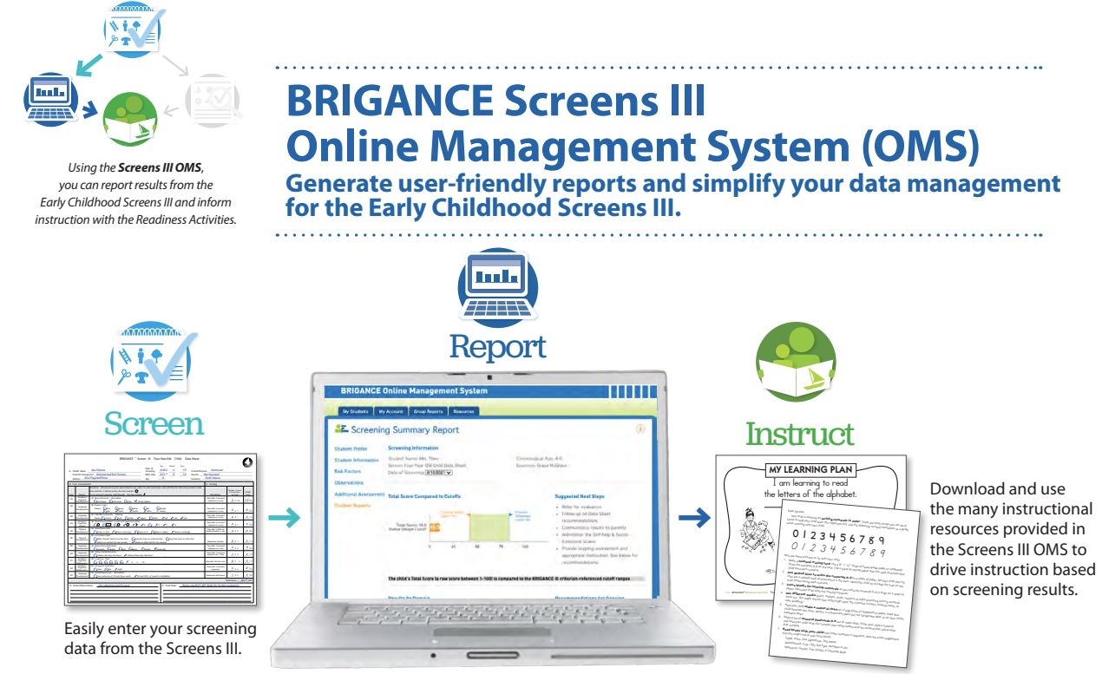
Notes:
Let's talk about the Online Management System!

Slide 7
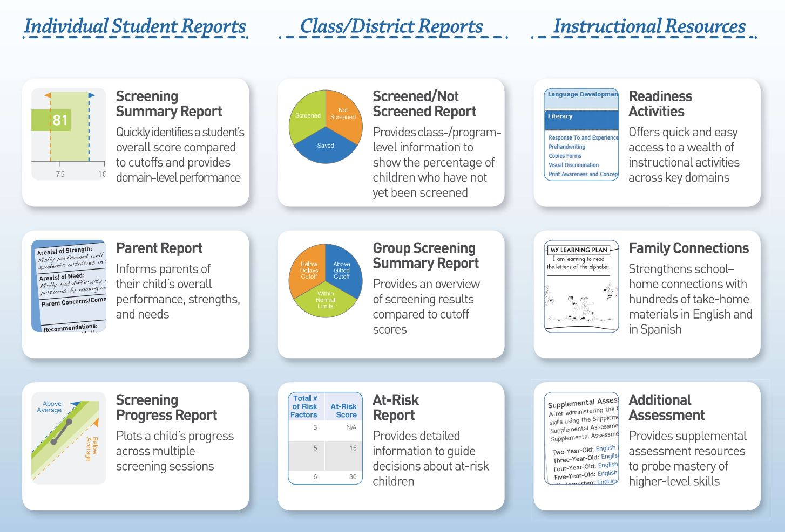
Notes:
Within the OMS, you'll find a plethora of individual student reports, class and district reports, along with instructional resources to engage students in next steps. The Online Management System provides parent reports and family letters in English and Spanish.

Slide 8
Overall Numbers for Fall 2024 Screening
School Districts Participating=17
Schools Participating=105
Number of Students Screened=5,011

Slide 9
Noticings
Gender, race, language, free/reduced data was spotty
  We need to improve entering this data
Adaptive behavior, self-help, and social-emotional data was scarce
  We need to be more intentional about including these assessments

Slide 10
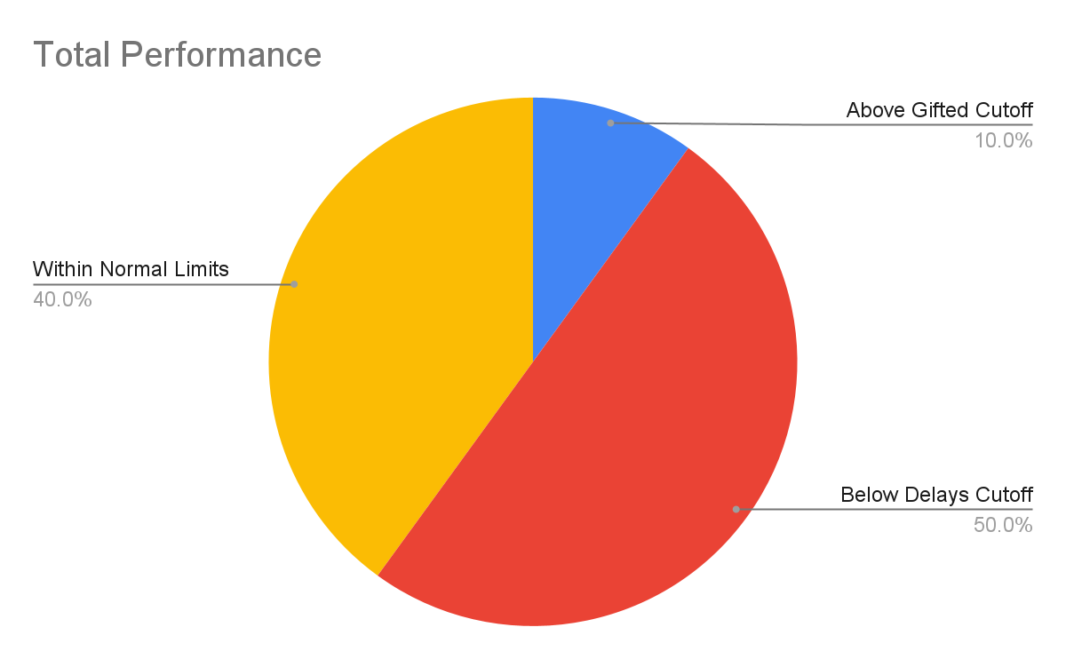

Slide 11
Total Performance
Performance Category | Number | Percentage
Above Gifted Cutoff | 513 | 11%
Below Delays Cutoff | 2381 | 49%
Within Normal Limits | 1920 | 40%
All Data in tables represents only the 5 year old tests (N=4814)
Raw Score Average=62.9%

Slide 12
Physical Development
Physical Development - the growth and development of both the brain and the body.
Strategies for Parents/Guardians: Work on gross motor skills by standing on one foot for ten seconds, walking backwards, and using their hands to build things with building blocks, Legos, and Play-dough. Practice drawing shapes such as: an X, square, rectangle, triangle, and diamond. Practice printing their first and last name.

Slide 13
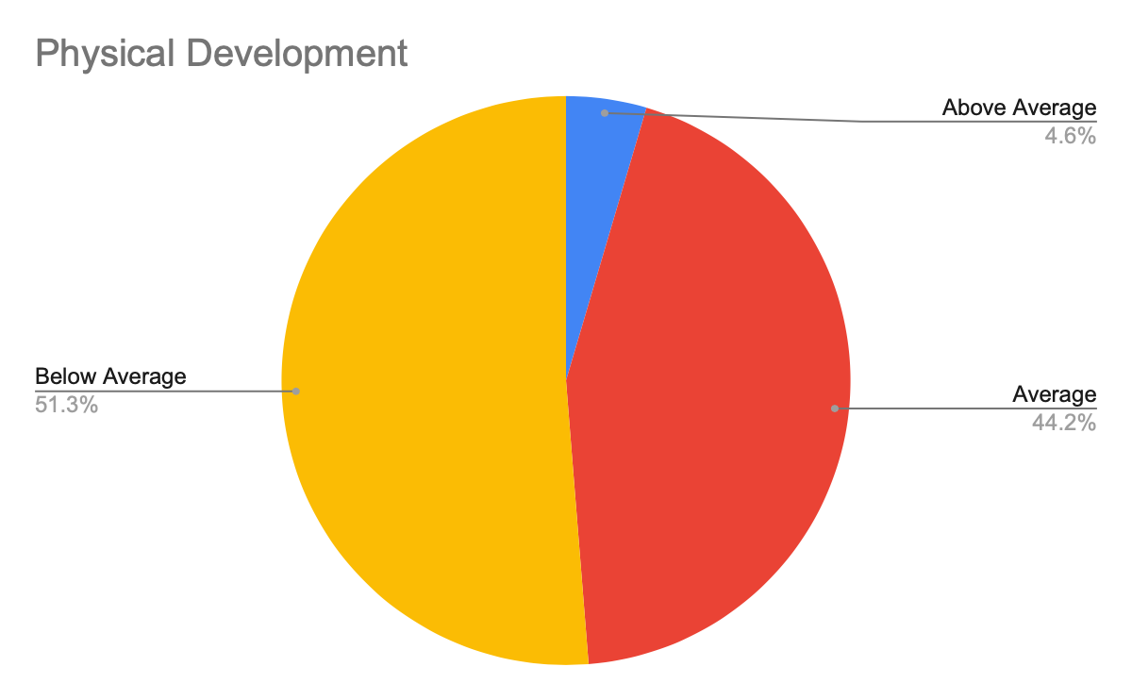

Slide 14
Physical Development Performance
Categories | All | Above | Below | Normal
Above Average | 220 | 155 | 7 | 7
Average | 2127 | 354 | 466 | 192
Below Average | 2469 | 4 | 1908 | 1721

Slide 15
Language Development
Language Development - the process by which children learn to understand and communicate using language.
Strategies for Parents/Guardians: Discuss things they see, hear, and touch. Encourage them to speak in complete sentences that are at least five words. Practice identifying things around them such as: objects in the home, cooking utensils, and parts of the body (thumbs, fingernails, chin, chest, elbows, and shoulders).

Slide 16
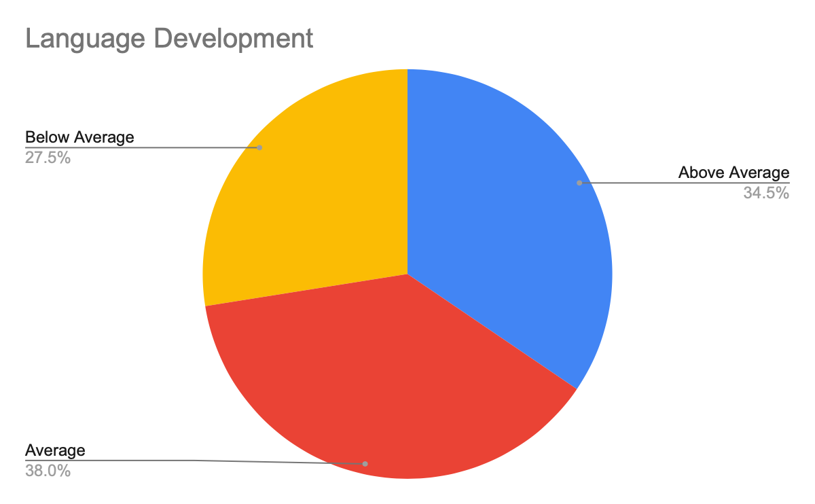

Slide 17
Language Development Performance
Categories | All | Above | Below | Normal
Above Average | 1639 | 379 | 416 | 116
Average | 1805 | 130 | 836 | 130
Below Average | 1307 | 249 | 1129 | 1674

Slide 18
Cognitive Development
Cognitive Development - the process by which children learn, think, and solve problems.
Strategies for Parents/Guardians: Practice knowing personal information (first/last name, age, birthday (month/day), telephone number, and address). Practice reciting and identifying the alphabet (in and out of letter order), sort objects by color, size, and shape, count from 1-30, and immerse them in books by reading to them, identifying front/back of the book, and showing them that text progresses from left to right and top to bottom.

Slide 19
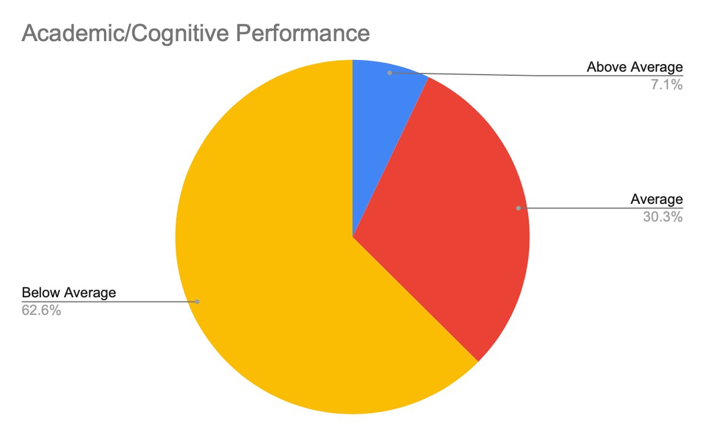

Slide 20
Academic/Cognitive Performance
Categories | All | Above | Below | Normal
Above Average | 341 | 306 | 0 | 35
Average | 1461 | 207 | 15 | 1238
Below Average | 3012 | 0 | 2366 | 647

