Slide 1
Virtual Town Hall: Friday, April 30 @ 10:30 CT / 11:30 ET
Reimagining Child Care In Tennessee
Special guests: State Senator Becky Massey, State Representative Patsy Hazlewood, expert Danielle Ewen with Education Counsel
Learn about new federal child care funding coming to Tennessee and important state legislation; and lend your ideas for how Tennessee can build child care back stronger.

Slide 2
Virtual Town Hall
Reimagining Child Care in Tennessee
AGENDA
Welcome
Child Care Task Force Bill Update and Sponsor Remarks
State and Federal Child Care Funding Opportunities Briefing
Q&A
Breakout Sessions: Reimagining Child Care in TN
Breakout Session Highlights
Next Steps and Adjourn

Slide 3
Virtual Town Hall
Reimagining Child Care in Tennessee
TENNESSEE CHILD CARE TASK FORCE: HB598 / SB677
Rep. Patsy Hazlewood / Sen. Becky Massey)
Passed House 91-0; Senate 29-0 (updated Mon. May 3)
Create a strategic action plan for QUALITY, AFFORDABLE, ACCESSIBLE child care in Tennessee
TQEE | 3

Slide 4
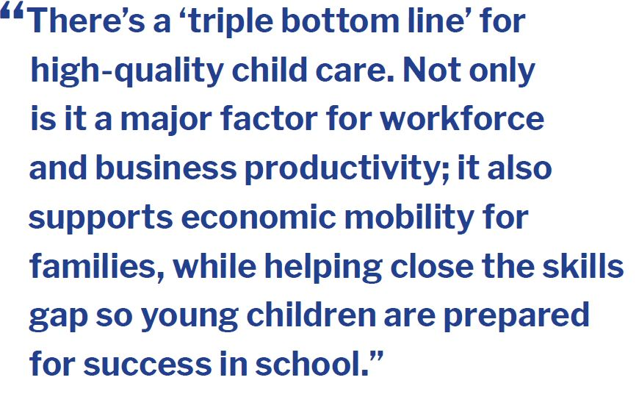
Child Care’s Triple Bottom Line
TQEE | 4

Slide 5
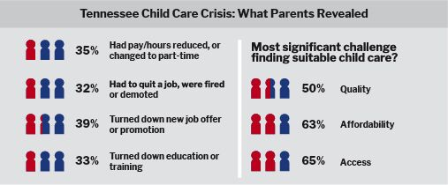
Adverse Economic Impact of Child Care Challenges
TQEE Fall 2019 Report: Want to Grow Tennessee’s Economy? Fix the Child Care Crisis
TQEE | 5

Slide 6
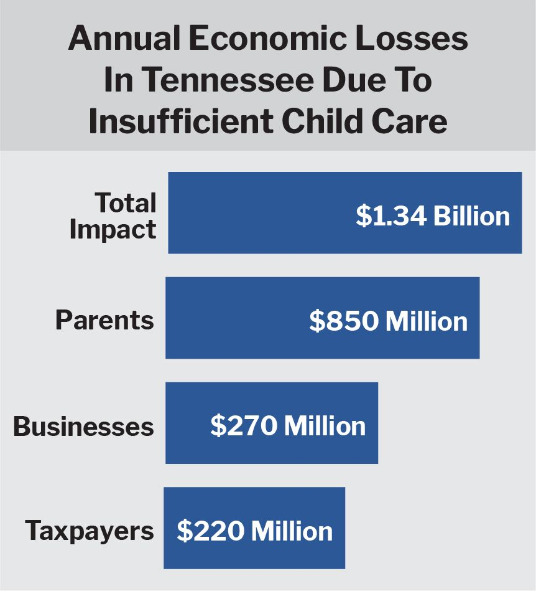
Adverse Economic Impact of Child Care Challenges
TQEE Fall 2019 Report:
Want to Grow Tennessee’s Economy? Fix the Child Care Crisis
TQEE | 6

Slide 7
Summary of Education / Child Care Funding in TN from Relief Packages
 | CARES Act Signed Mar 2020 Obligate 2022 Liquidate 2023 | CRRSA Signed Dec 2020 Obligate 2022 Liquidate 2023 | ARP Signed Mar 2021 Obligate 2022/23 Liquidate 2023/24
Early Childhood Education / Child Care | $82.4 million | $231 million | $911 million $356,950,731 -child care assistance $554,431,495 -child care stabilization
K-12 (ESSER) | $ 259.9 million | $1.1 billion | $2.5 billion
Governor’s Funds (GEER) | $63.5 million | $100 million | N/A
Total | $ 405.8 million | $1.43 billion | $3.41 billion
Plus Regular Annual Federal CCDBG Allocation in TN: $203 million
Notes:
Blair: Danielle, there have been a number of relief packages passed over the last year. Can you remind us of what they are and why they are important to Tennessee?
Danielle: Talks about amounts and implications for child care.
Blair: How long do states have to spend the funds? Tell us about obligate/liquidate, etc.
Danielle: highlight obligate/liquate dates on this slide.
Blair – ok, before we dive more into how we can spend this money, let’s talk about how Tennessee has spent / committed to spend some of the money thus far?

Slide 8
How Could Tennessee Use Relief Funds to Transform the Child Care System?
Helping Families Access and Afford Child Care
Stabilizing Child Care Programs
Compensating Child Care Providers
Building Supply and Quality of Providers
Coordination and Linkages with Other Systems
Notes:
Blair: That was really helpful. As we look forward, and think about using the relief funds to help transform our system here, how should we be thinking about uses of the funds? Should we continue with the same activities?

Slide 9
Short- and medium-term policy opportunities
Pay providers based on enrollment rather than attendance;
Provide PPE and other cleaning and sanitizing materials at no cost to providers;
Expand access to Head Start, Early Head Start, and full-day and year programs;
Increase availability of scholarships for providers;
Invest in mental health consultation for providers and families;
Create and support family child care networks and shared services;
Invest in child care resource and referral agencies to provide translations, technical assistance, and other supports to providers;
Provide a wage increase that can be given directly to classroom teachers and aides; and
Invest in grants to stabilize providers that fully fund costs.
Notes:
[HOLD—NOT TO BE USED ON SCREEN BUT CAN PROVIDE IDEAS IF NEEDED]

Slide 10
Longer-term policy changes
Increase access to child care subsidies by:
Increasing eligibility
Raising rates for all providers
Eliminate or lower co-payments and other parent fees
Create contracts to meet the needs of families and providers;
Improve data collection to identify gaps and address equity;
Coordinate with other systems, including:
Expanding ChildFind
Working with pediatricians to provide developmental assessments and vaccines
Supporting transition of children from early childhood programs to elementary school;
Increase access to home visiting programs; and
Encourage and support family child care providers to enroll in the CACFP.

Slide 11
Additional Components of American Rescue Plan
Fully refundable child tax credit
Expansion of child/dependent care tax credit
Stimulus payments to families
Funds for state and local governments
Increased funding for home visiting
Increased funding for IDEA, including funds for infants, toddlers, and preschoolers with special needs
New funds for students experiencing homelessness
Subsidies for COBRA premiums
Incentives for states to extend Medicaid supports for postpartum women for 12 months
Extended tax credits for providers who provide family leave
Extension of Pandemic EBT
Extension of SNAP increases

Slide 12
Virtual Town Hall
Reimagining Child Care in Tennessee
Breakout Sessions
for Input/Feedback

Slide 13
Reimagining Child Care In Tennessee
AFFORDABILITY
QUALITY
Tying provider reimbursement rates to cost of quality
Expanding payment assistance eligibility to more parents
Employer support (employee child care benefits)
Quality standards, measures and continuous improvement
Workforce pathways, development and compensation
Curriculum, instructional tools and materials
Health / mental health supports for providers and families
TQEE | 13

Slide 14
Reimagining Child Care In Tennessee
ACCESS
CROSS CUTTING
Accurate and timely supply and demand data
Family friendly navigation
Provider start-up / expansion incentives
Contracts with providers for underserved populations/ areas
Automation Tools (Child Care Management Software)
Child care system governance, monitoring, QRIS
Support for provider networks
TQEE | 14

Slide 15
Virtual Town Hall
Reimagining Child Care in Tennessee
Thank You

